Slide 1
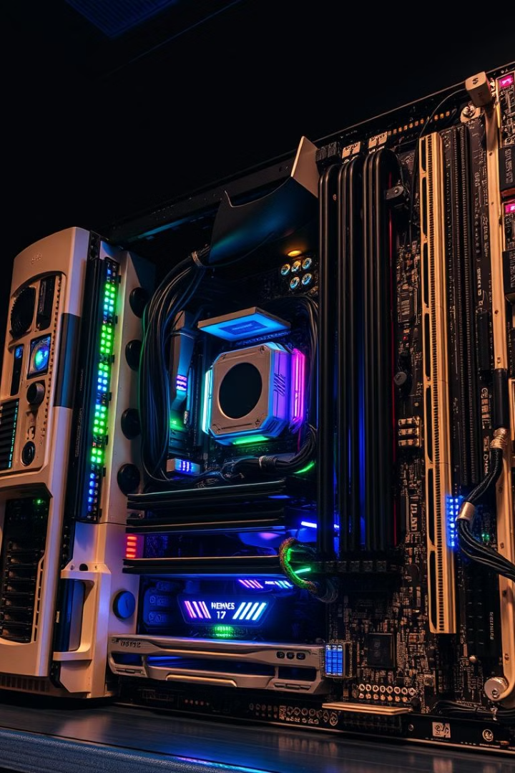
Memory Organization
Memory is crucial for computer operations, storing data and instructions for quick access. It's organized into different types, each with its unique characteristics and purpose.

Slide 2
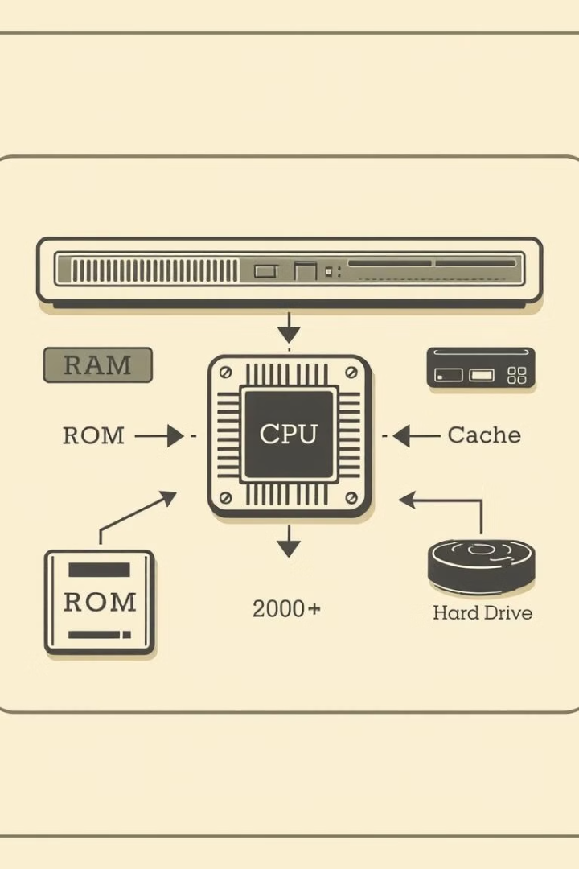
Main Memory
1
Structure
2
Types
Main memory, commonly referred to as RAM (Random Access Memory), is a type of volatile memory that stores data and instructions actively used by the CPU.
There are various types of RAM, including DRAM (Dynamic RAM) and SRAM (Static RAM), each offering different performance and cost trade-offs.
3
Characteristics
Main memory is characterized by its fast access speed, volatile nature (data is lost when power is off), and direct addressing capability.

Slide 3
Auxiliary Memory
Magnetic Storage
Optical Storage
Magnetic storage devices, such as hard disk drives (HDDs), utilize magnetic fields to record data on rotating platters. HDDs are typically slower but offer higher storage capacity and lower cost per byte compared to other forms of storage.
Optical storage devices, like CDs and DVDs, use lasers to read and write data on a reflective surface. They offer moderate storage capacity, portability, and durability, though access speeds are generally slower compared to magnetic storage.

Slide 4
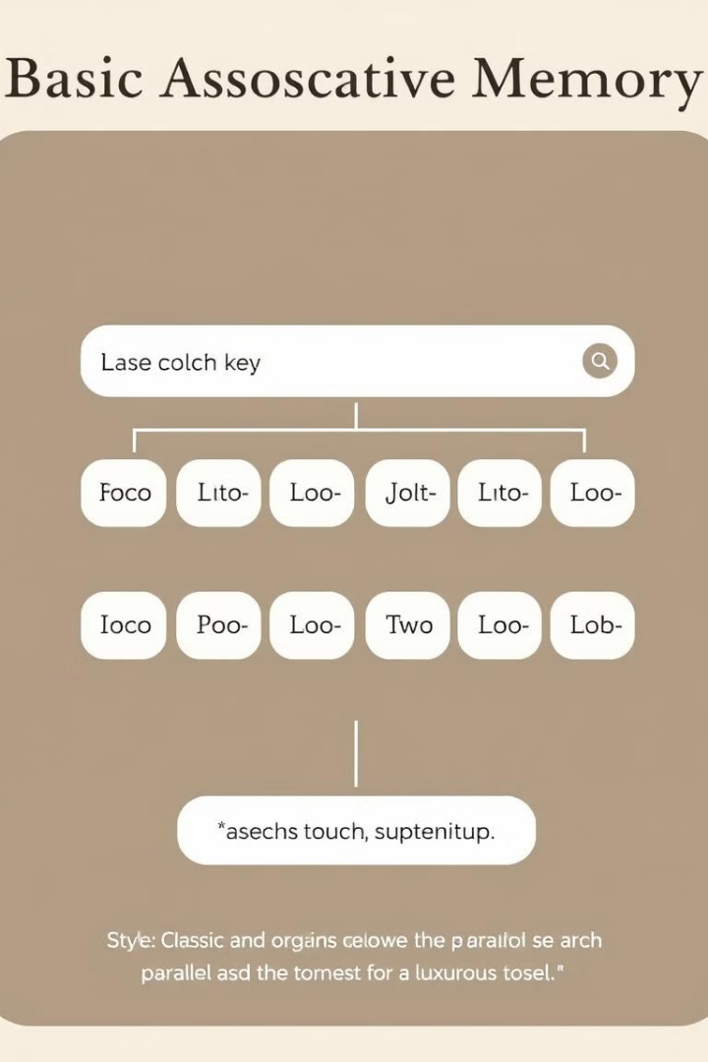
Associative Memory
Functionality
Applications
Associative memory, also known as content-addressable memory, allows direct access to data based on its content rather than its address. It performs parallel searches, finding all matching data items simultaneously.
Associative memory finds applications in databases, pattern recognition, and high-speed lookup tables. It's well-suited for tasks that require fast searching and retrieval of specific data based on its content.

Slide 5
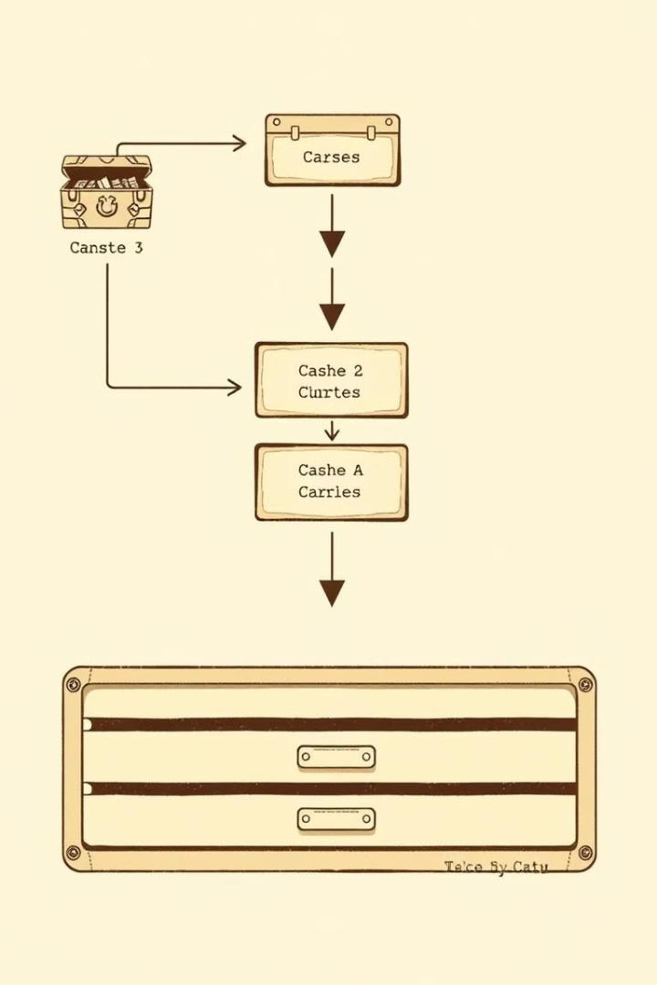
Cache Memory
1
Levels
Cache memory is a small, fast memory that stores frequently accessed data from main memory. It's organized in levels (L1, L2, L3), with each level providing faster access but smaller capacity.
2
Replacement Policies
When the cache is full, a replacement policy determines which data to evict to make room for new data. Common policies include LRU (Least Recently Used) and FIFO (First-In, First-Out).

Slide 6
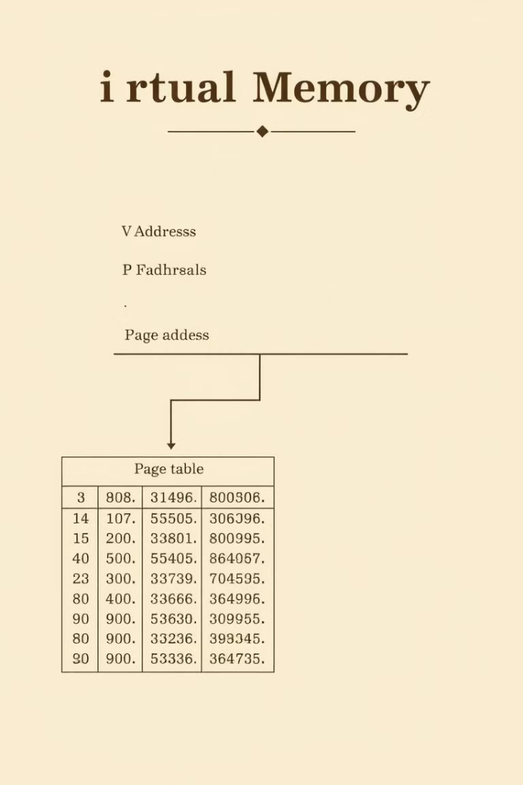

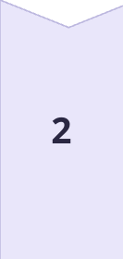
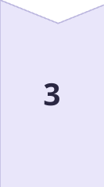
Virtual Memory
Paging
Paging divides the virtual memory into fixed-size units called pages. Physical memory is also divided into equal-sized frames. When a process accesses data, the virtual address is translated to a physical address using a page table.
Segmentation
Segmentation allows dividing a process's virtual memory into logical units called segments. These segments are of varying sizes and correspond to program modules or data structures. This approach enhances memory protection and sharing capabilities.
Demand Paging
Demand paging is a technique that brings pages into memory only when they are needed. This approach reduces the memory footprint of processes, enabling multiple processes to run concurrently.

Slide 7

Memory Hierarchy
Level
Speed
Cost
Capacity
Cache
Fastest
Highest
Smallest
Main Memory
Medium
Medium
Medium
Auxiliary Memory
Slowest
Lowest
Largest

Slide 8
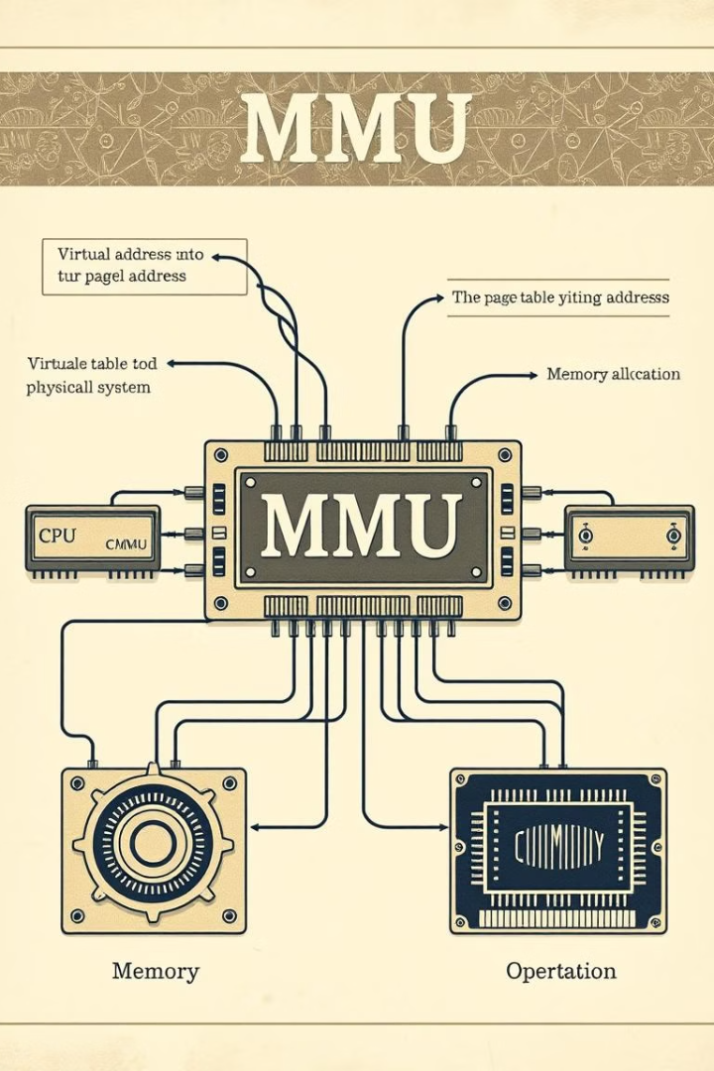



Memory Management
Allocation
Memory management involves allocating memory space to processes and ensuring that each process has the required resources to execute.
Protection
Memory protection mechanisms prevent one process from accessing or modifying the memory space of another process, ensuring integrity and security.
Sharing
Memory sharing allows multiple processes to access and modify the same memory locations, enabling efficient resource utilization and communication between processes.

Slide 9
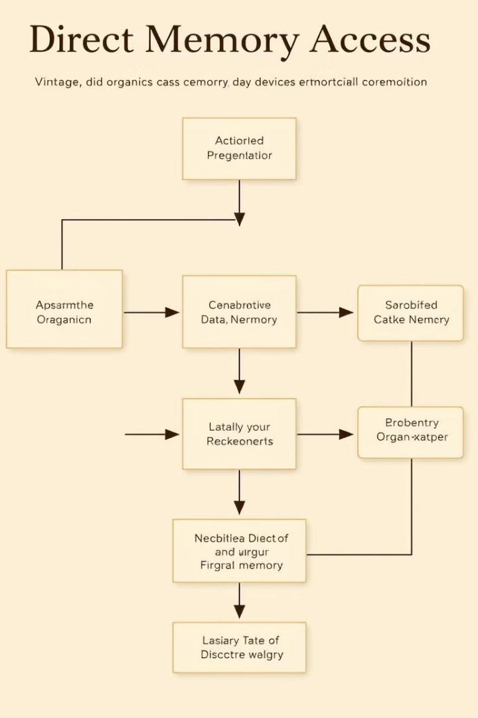
DMA and Memory Mapping
1
DMA
2
Memory Mapping
Direct Memory Access (DMA) enables peripheral devices to directly access main memory without involving the CPU, reducing the CPU's workload and improving data transfer performance.
Memory mapping assigns unique addresses to both physical and virtual memory locations, facilitating efficient access and management of memory resources within the system.

Slide 10
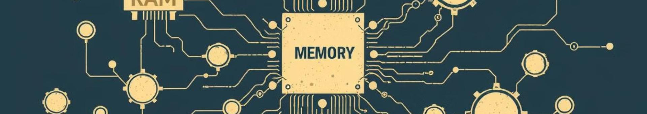
Trends in Memory Technology
Non-Volatile RAM
3D NAND Flash
Optical Memory
Non-volatile RAM (NVRAM) retains data even when power is off, offering the performance of DRAM with the persistence of flash memory. This technology promises to revolutionize computer systems by eliminating the need for separate storage devices.
3D NAND flash memory uses vertical stacking of memory cells, increasing storage density and performance. This technology enables smaller and more efficient storage devices, paving the way for larger capacity and faster data access.
Optical memory technologies, such as holographic storage, offer massive storage capacity with fast data access speeds. These advancements hold the potential for ultra-high density storage solutions.

